Slide 1
Building a Data Mesh Architecture in Azure
Data Mesh vs Azure (Theory vs Practice)

Slide 2
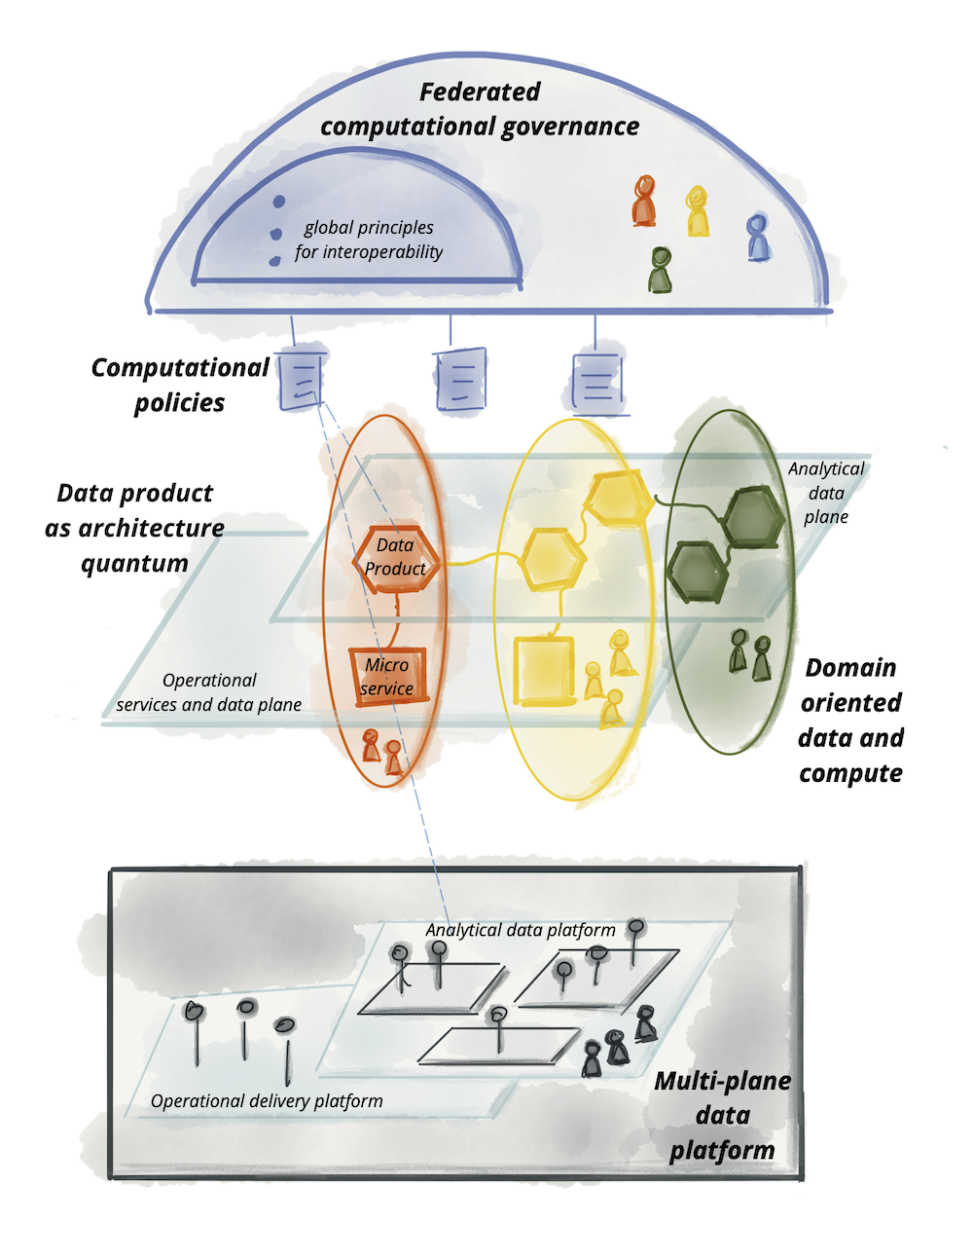
Data Mesh vs Azure – Part 1
Theory vs Practice
Image Source: https://martinfowler.com/articles/data-mesh-principles.html

Slide 3
Data Mesh vs Azure – Part 2
Theory vs Practice

